Slide 1
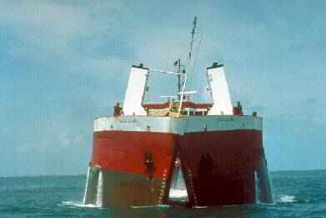
Navigation Program Overview
For Planning Associates
Jim Walker
Navigation Branch Chief
HQ USACE
16 May 2011
US Army Corps of Engineers
BUILDING STRONG®

Slide 2
Topics
Navigation Overview
Capital Investment Plans – a new model?
Remaining Relevant
WRDA – Nav Studies
Contributed Funds

Slide 3
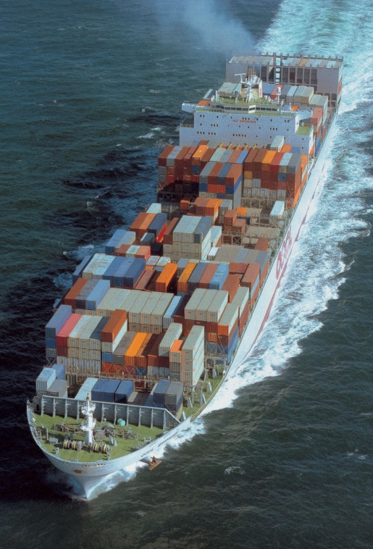
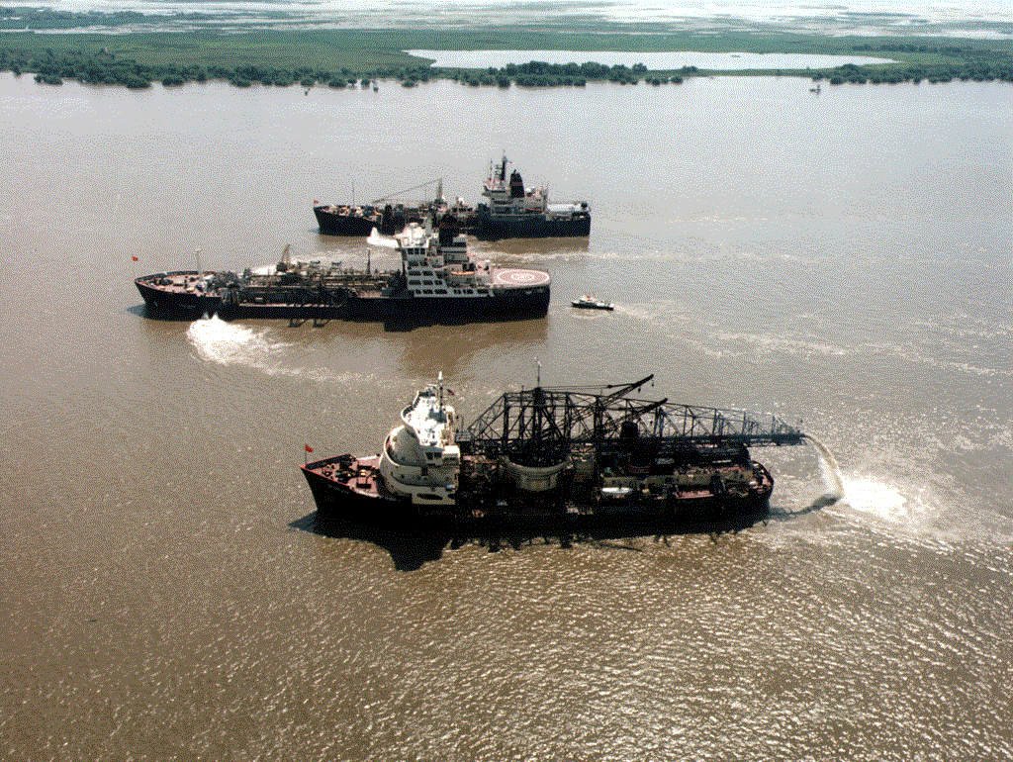
Corps Navigation Mission
Provide safe, reliable, efficient, effective and environmentally sustainable waterborne transportation systems for movement of commerce, national security needs, and recreation.
Notes:
First I have to start by stating our mission :
It is a bit wordy, but bottom line is- we provide reliable and resilient navigation infrastructure for movement of waterborne commerce.

Slide 4
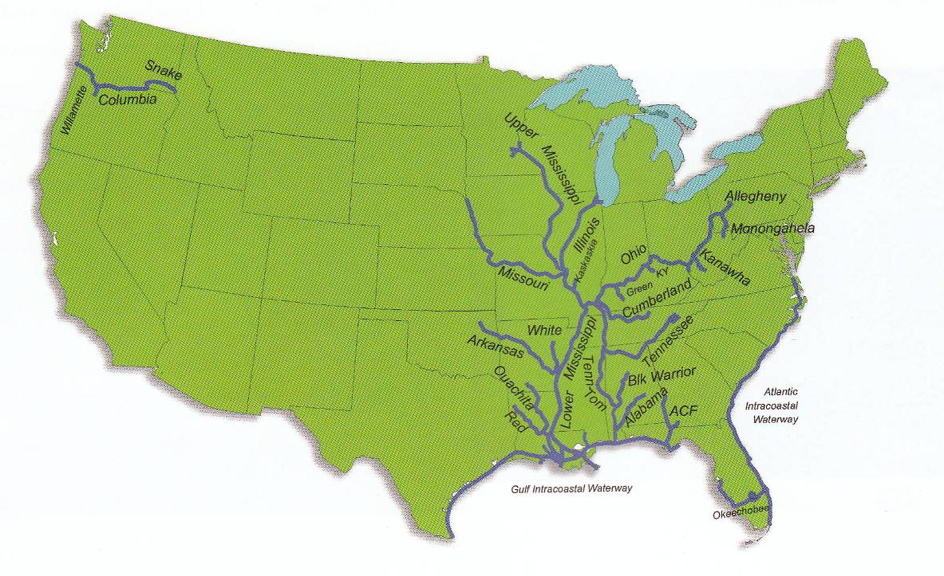
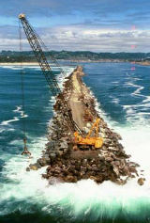
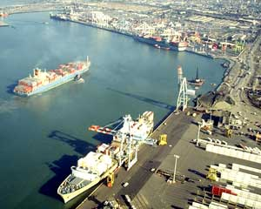
USACE Navigation Assets
INLAND NAVIGATION
27 Inland River Systems
207 lock chambers @ 171 lock sites
12,000 miles of inland river channels
COASTAL NAVIGATION
1067 Navigation Projects
19 lock chambers
13,000 miles of channels
929 navigation structures
844 bridges
Notes:
25,000 miles of commercially important waterways.
Coastal: 59 High Use, greater than 10M tons per year; 100 Moderate Use, 1-10M tons per year; 908 Base Use, less than 1M tons per year.
Navigation locks service life is 50 years, average age of locks is 53 years.
Channel dredging averages 280M cubic yards per year – new work and maintenance.
Structures - jetties, training works:
Breakwater 362, Jetty 272, Pier 97, Revetment 60, Groin 42, Dike 40, Bulkhead 10, Seawall 4, Other 42
Bridges vary from high use public bridges over Federal nav channels, mostly in NAD to culverts for vehicular traffic at project sites.

Slide 5
Administration Objectives
Double exports in 5 years
Improve the environment
Reduce Green House Gas (GHG) emissions
Reduce fossil fuel consumption
Navigation has a key role in all of these!
Notes:
The Presidents Exports initiative was issued Mar 2010
Double exports linked to deepening of coastal ports in preparation of new Panama Canal locks opening in 2014 and accommodating 50’ draft ships

Slide 6
Navigation Funding – Pres Budget ($million)
Pres Bud | Coastal | Inland | Nav | CW total | Nav Percent
FY12 | $832 | $744 | $1576 | $4631 | 34
FY11 | $873 | $779 | $1652 | $4939 | 33
FY10 | $971 | $796 | $1767 | $5125 | 35
FY09 | $969 | $931 | $1900 | $4741 | 40
FY08 | $957 | $1057 | $2014 | $4900 | 41
Trend is declining funds
Navigation down 22% in the last 5 years.
Reductions masked by ARRA funding in FY09 and FY10
Flood Damage Reduction increased due to DSAC results; Environment also increased.
Notes:
Inland Construction has decreased due to IWTF constraints
Emphasis on FDR with Dam Safety Actions
Answering the question ‘So what?’ Flat budgets result in reduced buying power given increased dredging costs – fuel, steel, labor, about 30% in last 3 years. Result is decreased channel availability and increased unscheduled lock closures.

Slide 7
FY12 O&M Budget Coastal Navigation
Category | Inventory | Commerce | FY12 O&M Projects | FY12 O&M Funds | FY11 O&M Proj. | FY11 O&M Funds
High Use | 59 | 90% | 54 | 62% |  | 62%
Moderate Use | 100 | 9% | 61 | 25% | 120* | 21%
Low Use | 908 | 1% | 41 | 6% | 124 | 10%
Other |  |  |  | 7% |  | 7%
Total | 1067 | 100% | 156 | 100% | 244 | 100%
Prior to FY12 we adjusted to budget decreases by minor reductions at almost all nav projects.
The low use category was proposed as a program for 50% reduction in the FY12 budget development; This was a 50% dollar reduction, not a 50% projects reduction
‘Other’ includes Nav R&D, Project Condition Surveys, Remaining Items, etc.
IMPACT: Risk of navigation related incidents and fatalities increase at non-dredged projects.
*High and moderate use were not separately identified in FY11
Notes:
High Use: Los Angeles and Long Beach had no funds requested; Also some projects report tonnage separately but are budgeted under 1 project for example: Newport News/Norfolk/Thimble Shoal; Tolchester/Baltimore and Port of NY/NJ
In addition to the funded projects there are 35 Project Condition Survey work packages and 1 Removal of Aquatic Growth in FY11 and 12.
OMB guidance contained in M-10-20

Slide 8
Coastal Navigation Capital Investment Program
Operate &
Maintain
Plan
Design
Construct
7 Projects: Jax, SNWW, Boston, Freeport, Brazos Island, Great Lakes, Palm Beach
3 Projects
NY/NJ
Delaware Rvr (Cong Add) Sacramento/Stockton
1 Project
In PED: Savannah
Annual
O&M
Budget
Replace, Recapitalize, Retire
Divest
Notes:
Studies:
Jax is 40’, considering 45’
SNWW is 40’, considering 45’
Freeport is 45’, considering down to 60’
Brazos is 42’, considering down to 60’
Great Lakes is multiple projects, depths vary
Palm Beach is 35’, considering
Deepening
NY/NJ is going to 50’
Delaware River is going to 45’ (in FY11 Sen, not House)
Sacramento Deep Water Ship Canal (Stockton) is 30’ going to 35’
Soo locks: Cong add in FY11, BCR 0.8

Slide 9
Ready for the Panama Canal: US Harbors 45’ or Greater
WEST COAST
Seattle/Tacoma (>50’)
Oakland (50’)
LA/LB (>50’)
San Diego (47’)
EAST COAST
NY/NJ (50’ underway)
Baltimore (50’)
Hampton Roads (50’)
Charleston
Morehead City
GULF COAST
Mobile
New Orleans
Houston/Galveston/Texas City
Corpus Christi
Freeport
Notes:
45’ good, but 50’ needed for future and future is soon. Panama Canal can pass ships with 50’ draft.

Slide 10
Coastal Navigation Channel Performance
CL
High Use Projects, >10M tons/year
Goal: Half channel width, 95% of time
Actual: 35% of time
Qtr Pt
Qtr Pt
Toe
Toe
Advanced Maintenance
Allowable Overdepth
Analogy to building a 2-lane road; Present funding allows one lane, one-third of the year
Notes:
The takeaway from this slide is present O&M funding is only providing half the channel width available one third of the time at our Nation’s highest use channels.

Slide 11
Coastal Navigation Initiatives
Need a capital investment strategic plan for coastal navigation
Studies: No new starts or new phases
Efficiently fund study, design and construction

Slide 12
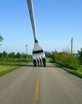
Coastal Nav Future
Status Quo
Continued O&M funding reductions
Reduce number of maintained projects
Scope dredging to available funding
Reduced channel availability
Minimal Capital Investment work – channel deepenings
Proactive Efforts
HMTF revision
Establish a Coastal Nav Capital Investment Program
Pursue Environmental Improvements in BCR
Establish Administration Projects of National Priority

Slide 13
FY12 O&M Budget Inland Navigation
Category | Rivers/ Waterways | Locks | Commerce Ton-Miles | FY12 O&M | FY11 O&M
High Use | 16 | 136 | 97% | 93% | 90%
Moderate Use | N/A
Low Use | 11 | 37 | 3% | 7% | 10%
Total | 27 | 173 | 100%
Low commercial use projects took a 50% reduction in FY12 budget.
FY13 Budget guidance establishes Moderate Use for Inland as 1-3B ton-miles
IMPACT: Lower transportation savings impacts global competitiveness of US exports. Risk of navigation related incidents and fatalities increase at minimally maintained projects.
ACTION: Determine minimal O&M requirements for ‘Caretaker’ status
Notes:
OMB guidance contained in M-10-20

Slide 14
Inland Navigation Capital Investment Program
Operate &
Maintain
Plan
Design
Construct
4 Projects:
Upper Ohio, PA
Missouri River
GIWW – Calcasieu
GIWW channel, TX
2 Projects
In PED:
Upper Miss,
GIWW - Bayou Sorrel, LA
4 Projects
Olmsted, Emsworth,
Monongahela Locks 2, 3 &4, PA
MS River Lock 27
Annual
O&M
Budget
Note: 2 Projects suspended in FY12
Chickamauga, TN Kentucky Lock, KY
Replace, Recapitalize, Retire
Divest
Notes:
All the Planning Studies are in the Feasibility Phase
Olmsted is a stability (safety) issue; top priority, funded at capability, complete in 2018
Emsworth presently estimated to be funded to completion in FY13
Lower Mon 2, 3 & 4 complete in FY23 at present IWTF revenues
No construction funds in FY12 budget for Chickamauga or Kentucky locks due to depleted IWTF;
Chick resume in 2022, Kentucky in 2023
Upper Miss – 7 locks, construction would start w/Lock 25 and Lock 22. Selected for different foundations that can be applied to other locks

Slide 15
Navigation Performance
USACE Campaign Goal Objective 3c:
Deliver reliable infrastructure using a risk-informed asset management strategy
High Performing Goal:
INLAND NAVIGATION:
Scheduled & Unscheduled
lock closures due to
mechanical breakdowns
Less than 5-yr average
Not achieving
Notes:
Status: Trend is increasing outages; Improvement subject of Investment Strategy
2008 included IHNC extended closure for 82 days.
Data: Same as used for OMB PART
Coastal ‘developing’ data for mid-use and base use projects; we have data for high use projects

Slide 16
Inland Navigation Initiatives
IMTS Board of Directors
Navigation Lock Staffing
Navigation Lock Levels of Service
IMTS Working Group
Lock Operator Training and Certification
Lock Operator Position Descriptions
IMTS Maintenance Standard
Inland Waterways Users Board
Implementing CPBM Recommendations
IWTF: Status Quo - 3 projects
Maintenance Engineers

Slide 17
Which Way for IMTS?
Status Quo
Continued O&M funding reductions
Increased risk of major mechanical breakdown and extended IMTS closure
Reduced IMTS availability
Reduced reliability
Minimal Capital Investment work
Proactive Efforts
IWTF revision implemented
IMTS Capital investment program implemented – thousands of US crafts jobs
Reliability and Resiliency increases
Presidential objectives accomplished

Slide 18
Navigation Topics
Capital Investment Plans – a new model?
Planning Program – Nav Studies
Remaining Relevant
WRDA
Contributed Funds

Slide 19
Coastal Nav Investment Plan
Build on success of IMTS CPBM and Hydropower Modernization Initiative
Determine key projects
Team of Corps, Ports and Shippers
Post Panama Canal and beyond
Others studies continue but selected projects funded at capability

Slide 20
Planning Program Trends
 |  | Inland | Coastal | Navigation | Environ. Restor. | Mixed | Total
Chiefs Rpts | Reports | 3 | 2 | 1 | 3 | 1¹ | 10
Since | Projects | 3 | 5 | 1 | 17 |  | 26
WRDA ‘07 | $B | 1.5 | 0.71 | 0.03 | 4.2 |  | 6.44
Add’l Chief’s | Reports | 2 | 1 | 3 | 7² | 1 | 14
Rpts by Dec 11 | Projects | 2 | 1 | 3 | 10 | 1 | 17
Totals | Reports | 5 | 3 | 4 | 10 | 2 | 24
Totals | Projects | 5 | 6 | 4 | 27 | 1 | 43
Flood Risk Mgmt
Notes:
The MsCIP Chief’s Report accounts for two Coastal Flood Risk Mgmt projects and 10 ecosystem restoration projects. The LCA 6 Chief’s Report accounts for 6 ecosystem restoration projects. The impetus for the MsCIP and LCA projects was post-Katrina authorizations by Congress. The only other ENV project is Mid-Bay, which supports a navigation project by containing 95 mcyds of dredged material.
The 7 additional ecosystem reports included 3 from Coastal Louisiana (LCA 4, LCA Barataria, and MRGO) and 2 from the Everglades (Broward County and Biscayne).
Notes:
Prioritize and program planning new starts to achieve mission objectives
Prioritize and program construction new starts to achieve mission objectives
Chief’s Reports Complete since WRDA 07
10 reports, 26 projects ~$6.5 b.
FRM = 3@$1.5b; CSDRR=5@$592m initial construction; Nav=1@$25m; ER=17@$4.2b.
Chief’s Reports to be Completed by Dec 2011
16 reports, 19 projects
FRM=3; CSDRR=1; Nav=3; ER=11
Navigation Studies – FY12 Budget
Nav BL received $11 million for Remaining Items; $7.1 million for studies
Unfunded
Recons: 30 projects for $3.9 million of which 28 were new starts
Feasibilities:
34 projects for $21.4 million requested (12 new starts);
9 budgeted (3 completions and 6 continuing) fir $4.5 million
PEDs
26 projects for $37.4 million requested (14 new starts)
2 budgeted for $2.6 million

Slide 21
Navigation Studies - Strategic Failure??
FY12 Budget, Navigation Studies, Investigations Account
$18M Total; $7M for Studies, $11M for Remaining Items
$18M of $104M total GI (Nav: 17% of GI vs 32% of total program)
Recons: Funded: 0; Unfunded: 30 projects for $3.9 million of which 28 were new starts
Feasibilities: Funded: 9 (3 completions; 6 continue) $4.5M
Unfunded: 34 projects for $21.4 mil (12 new starts)
PEDs Funded: 2 projects for $2.6 million
Unfunded: 26 projects for $37.4 million (14 new starts)
Are we preparing the Nation for post-Panamax Vessels?
If we did fund more Nav studies….which ones?
Notes:
Navigation Studies – FY12 Budget
Nav BL received $11 million for Remaining Items; $7.1 million for studies
Unfunded
Recons: We did not fund 30 projects for $3.9 million of which 28 were new starts
Feasibilities:
34 projects for $21.4 million were requested (12 new starts);
We budgeted only 9 Nav studies (3 completions and 6 continuing) fir $4.5 million
PEDs
26 projects for $37.4 million were requested (14 new starts)
We budgeted 2 studies for $2.6 million
So… There were additional Nav studies that could have been budgeted. We just didn’t select them.
The Navigation Business Line is about 32% of our total program but only 17% of the Investigations Program---which determines where we spend our future construction money. Have we erred by not allocating more funds to the study of deep draft channels. We certainly had opportunities to fund more nav studies.
And if we did, which of the Nav studies would we have selected?
Would we have looked at intersection of projects with likelihood to receive post-Panamax vessels?
Would we have looked at intersection of projects with DOT intermodal investments?
What should be our strategy for selecting studies?

Slide 22
Remaining Relevant
Trend of ports/sponsors choosing to abandon the Federal planning process
Port of Miami
Freeport channel widening
Port of Corpus Christi – LaQuinta Channel
Takes too long, costs too much

Slide 23
WRDA
Key to Navigation program’s future - Most significant legislation since WRDA ’86
WRDA viewed as a spending bill
Possible ‘CW BRAC’ of inactive navigation projects
Estimate dredging cost for these projects and show CW BRAC as a cost avoidance to offset perception of a WRDA ‘spending bill’
April letter to Budget Comm from 34 House Reps
Be optimistic!

Slide 24
Contributed Funds
Increased consideration by sponsors and non-sponsors in contributing funds
New Work and O&M
Beneficial Use of Dredged Material
Existing process very time consuming
Need to review process and streamline process

Slide 25
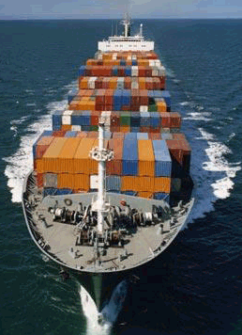
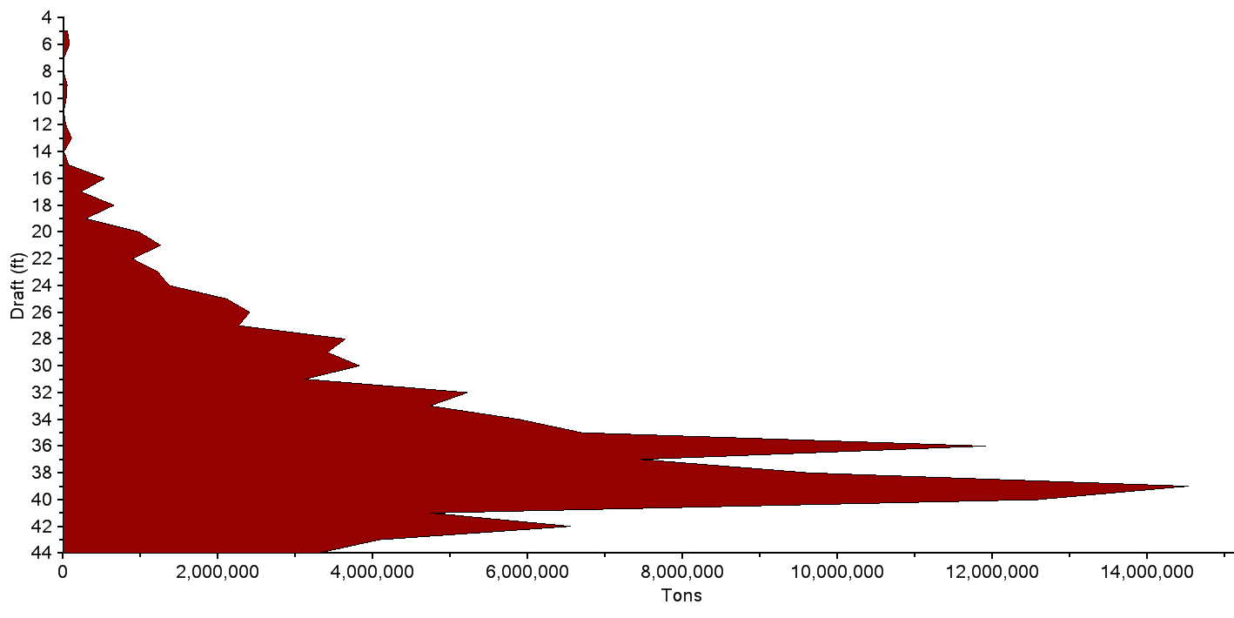
Channel Portfolio Tool (CPT)
Portfolio management for USACE navigation
channels should account for both physical
condition and depth utilization in prioritizing
projects for O&M funding.
By focusing on the cargo at the marginal, shoal-vulnerable depths, CPT provides a more complete indication of the significance of maintenance dredging.

Slide 26
Pieces of the Navigation Budget Process
OCA
Condition Assessments developed by IMTS BPR group implemented by MSC Teams
P(f)
Probability of Failure from MSC SME’s led by Risk Management Center
MIF SIF
Mission and Safety Importance Factors (MIF and SIF) from MSC Teams
$
Economic Consequences from Nav PCX
Notes:
OVER 166,000 records nationwide in OCA database

Slide 27
Key Points
Navigation funding is an essential component for the Nation’s Global trade – Economy, Jobs and Exports
WRDA is key to the Nation’s economic future
Need senior Administration discussion on national commitment to shipping, global trade and navigation infrastructure
What does this Administration seek as its legacy for navigation?
Notes:
Concern for HQ intellectual capital dedicated to indirect efforts – global water issues, climate change
What will keep the USACE technical organizations challenged with important work for the Nation? Planning, Engineering and Construction are on a bad trendline

Slide 28
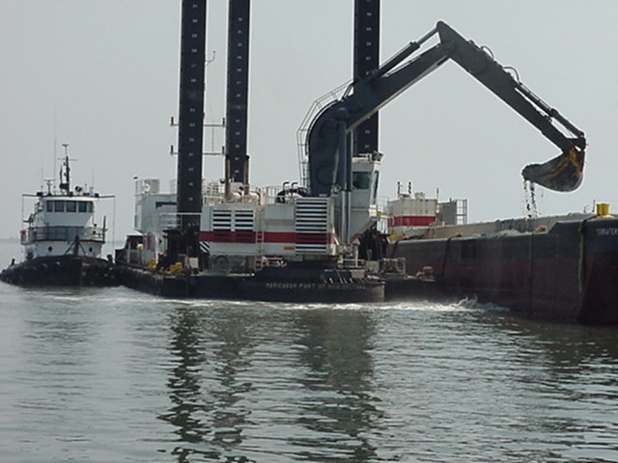
Summary
What do we do?
Provide Navigation infrastructure that is Reliable, Efficient, Resilient and Environmentally Sustainable.
Why is it important?
This infrastructure enables American goods to compete in the Global marketplace
Economy, Jobs and Exports!
Notes:
MG Grisoli asked these questions be addressed in his orientation briefing as incoming DCW and I thought I’d share them with you. Hopefully you agree with this focus, if not let me know.

